Slide 1
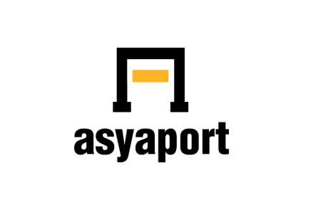
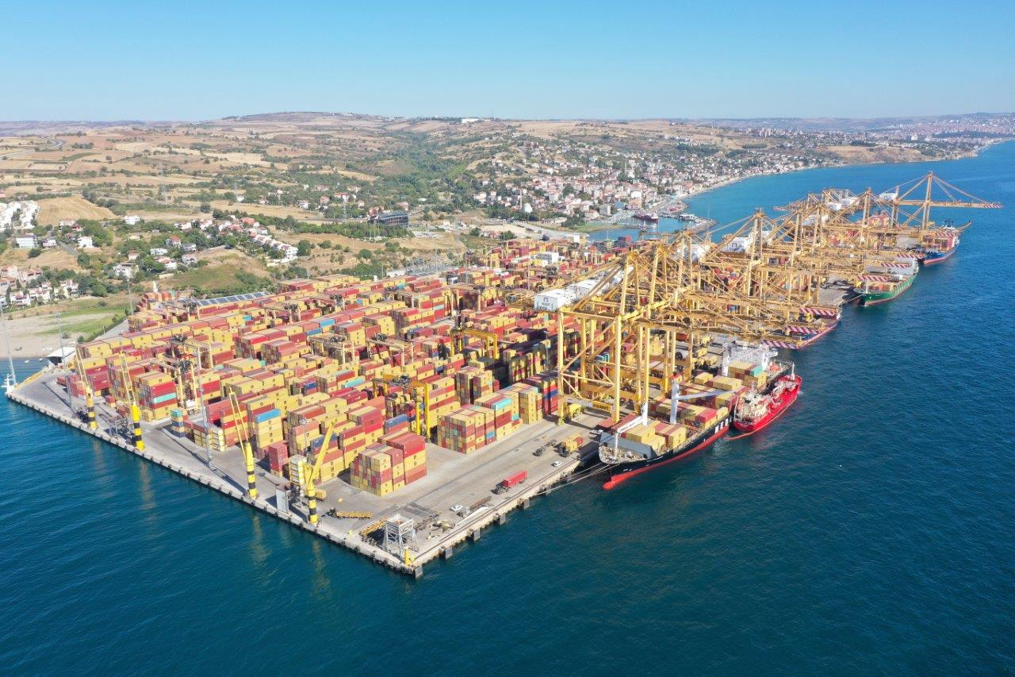
ASYAPORT
ÇEVRE RAPORU
2022
ASYAPORT
ENVIRONMENTAL REPORT
2022

Slide 2
ENVIRONMENTAL REPORT 2022
Name of Workplace | ASYAPORT LİMAN A. Ş.
Address | Barbaros Mahallesi Denizciler Sokak No:10 Süleymanpaşa/TEKİRDAĞ
Phone Fax | +90 0282 273 17 18 +90 0282 273 19 29
E-mail Adderss | info@asyaport.com
Tax and Number | ÜSKÜDAR 091 050 1866

Slide 3
ENVIRONMENTAL REPORT 2022
GENERAL INFORMATION ABOUT THE ASYAPORT
Asyaport is a $500 million project to build a greenfield container terminal at Tekirdağ on the Marmara Sea, approximately 70 km from Istanbul in Türkiye. It is a deep-water site, strategically located to serve as a transshipment hub for containers destined for the Black Sea traveling via the Bosphorus Strait and it is the first Transshipment Container Terminal (Hub Port) of Türkiye.
As of 2022, Asyaport is designed to handle a maximum annual throughput of 2.5 million TEU. This is achieved with the help of 11 ship-to-shore container cranes, 30 rubber-tyred gantry cranes, three reach stackers, five empty container handlers, 75 terminal trucks, and three ship cranes.
Asyaport has 300.000 m² port field and 2010 m total quay length. The terminal can handle container vessels with a capacity of up to 24,000 TEU with a maximum draught of 18 meters.
Asyaport, developing as a logistics center, provides significant contribution to business life of Tekirdağ with 1200 direct employment.

Slide 4
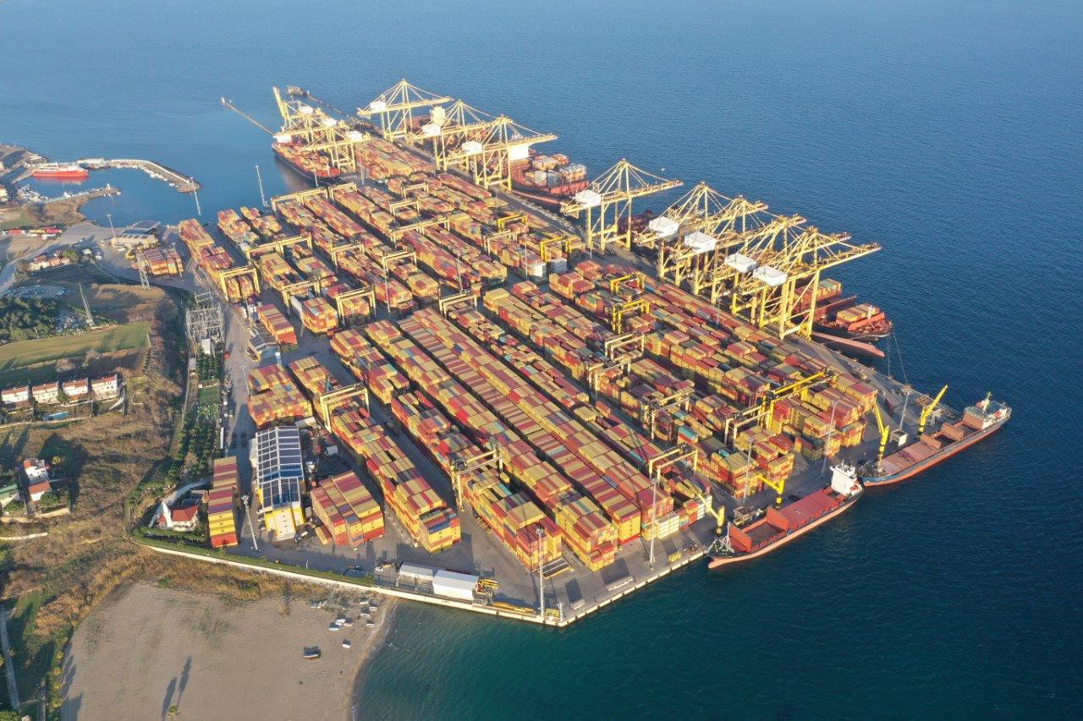
ENVIRONMENTAL REPORT 2022
• 300.000 m² port field
• 2010 m quay length
• Annual 2.5 million TEU total capacity
• 18 m water depth
• 1400 reefer container capacity
• 91.200 TEU intake capacity
(50.934 TEU at port, 40.266 TEU at depot)
EQUPMENTS
• 11 STS Ship to Shore Crane
• 4 SCR Electrical Ship Crane
• 30 RTG (Rubber Tyred Gantry)
• 75 TT LNG powered Terminal Truck
• 3 RST Reach Stacker
• 5 ECH Empty Container Handler • Monthly average 90 ship calls in 2022
KEY FIGURES

Slide 5
ENVIRONMENTAL REPORT 2022
2022 ENVIRONMENTAL REPORT CONTENT
ASYAPORT ORGANIZATION CHART
SUSTAINABILITY IN ASYAPORT
ASYAPORT INTEGRATED MANAGEMENT SYSTEM POLICY
ASYAPORT MANAGEMENT SYSTEM
COMPLIANCE WITH LAW
ENERGY, NATURAL RESOURCES USE AND RESOURCES
WASTE MANAGEMENT
WATER AND WASTEWATER TREATMENT
AIR POLLUTION CONTROL
GREENHOUSE GASES MANAGEMENT
NOISE MANAGEMENT
SOIL POLLUTION
MANAGEMENT OF CHEMICALS
ZERO WASTE MANAGEMENT
ENVIRONMENTAL TRAINING

Slide 6
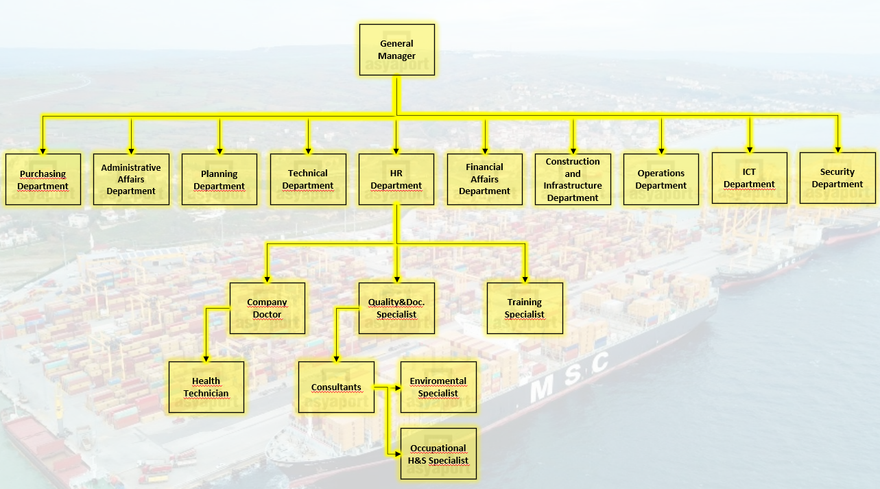
ENVIRONMENTAL REPORT 2022

Slide 7
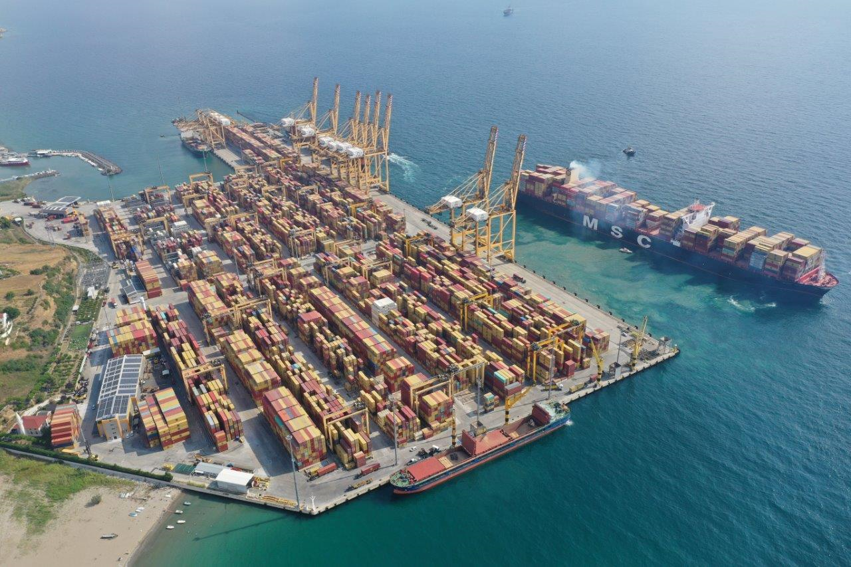
ENVIRONMENTAL REPORT 2022
SUSTAINABILITY
Asyaport; With its business objective based on strategic thinking, planning technology, careful investment, decisions and continuous disclosure, it aims to be a sustainable port that can meet the needs.

Slide 8
ENVIRONMENTAL REPORT 2022
INTEGRATED MANAGEMENT SYSTEM POLICY
Türkiye's first transit container port, Asyaport Liman A.Ş. Contributing to the country's economy with its continuous growth and investments as a logistics center; It is Türkiye's gateway to the World, which takes care of the environment and people in every period of its main business, and thinks of expansion as well as today. In this direction;
• To meet the requirements of customers and all interested parties and to provide customer visits,
• To provide human, information, technology and financial resources for the effective use of Integrated Management Systems,
• To fully comply with all legal and other eligibility requirements in our activities,
• Achieving measurable targets related to Environmental Quality, Occupational Health and Safety, Energy Management Systems and the continuous results of our management systems by making good use of port industry and transportation practices,
• To reduce the Occupational Health and Safety risks to an acceptable level,

Slide 9
ENVIRONMENTAL REPORT 2022
ASYAPORT INTEGRATED MANAGEMENT SYSTEM POLICY
• To create a safe working environment by considering the Occupational Health and Safety hazards and risks,
• To take measures to reduce our wastes and to ensure that they are recovered through recycling,
• To reduce greenhouse gas emissions,
• Focusing on people and assignment by targeting our environment,
• Efficient use of raw materials, energy and natural resources,
• To ensure the protection of ecosystems, sea creatures and all biodiversity,
• To be prepared at the maximum level in order to minimize an accident or incident that may occur in the port,
• To ensure that our employees and employees benefit and contribute,

Slide 10
ENVIRONMENTAL REPORT 2022
ASYAPORT INTEGRATED MANAGEMENT SYSTEM POLICY
• To ensure that our employees have certificates from the degrees brought by their duties,
• Developing projects to minimize the load in the protective port area,
• It is in cooperation with other ports around the world by using a common automation system,
• To contribute to sustainable production by following the technology and choosing equipment, systems and services with high energy costs,
• Publishing annual reports, promoting good interpretation environments of port developments,
• To raise awareness of our employees, subcontractors and consumption through trainings, to create efficient and to develop consumers in a positive way,
• To keep the Integrated Management System Policy up-to-date according to the Quality, Occupational Health and Safety, Environmental and Energy Management Systems audit results and result requirements,
• It undertakes to announce this committed and implemented policy to all our employees and to make it accessible to the public and third parties

Slide 11
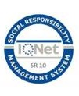
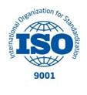
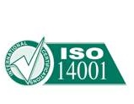
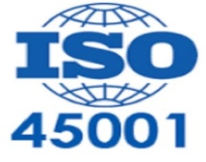
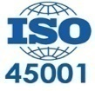
ENVIRONMENTAL REPORT 2022
ASYAPORT MANAGEMENT SYSTEMS
ASYAPORT Quality, OHS, Environment, Energy, Social Responsibility, Green Port, ECOPORTS and Information Security Management Systems are implemented.
ISO 9001 QUALITY MANAGEMET SYSTEMS
ISO 14001 ENVİROMENT MANAGEMET SYSTEMS
ISO 45001 OHS MANAGEMET SYSTEMS
ISO 50001 ENERGY MANAGEMET SYSTEMS
ISO 27001 INFORMATİON SECURİTY MANAGEMET SYSTEMS
ECOPORTS PERS CERTIFIED
GREENPORT
14064-1 GREENHOUSE GAS VERICATION STATEMENT
IQ Net SR 10 - SOCİAL RESPONSIBILITY MANAGEMET SYSTEMS
ZERO WASTE CERTIFICATE

Slide 12
ENVIRONMENTAL REPORT 2022
COMPLIANCE WITH LAW
ASYAPORT carries out all the activities and operations in Türkiye and abroad within the framework of laws and international law. It attaches importance to correct and timely communication in its relations with legal regulatory agencies and organizations.
Activities; It carries out laws, regulations and professional standards in accordance with the ASYAPORT Ethical Principles. All legal conditions are monitored daily via the official newspaper, changes are made in legal conditions to be announced to the relevant units and actions are taken and monitored through the LS SEÇK-020 Legal and Other Terms Tracking List Ordinary Conditions Follow-up List.
In 2022, there is not any inappropriate situation with regard to the legal requirements for the environment.

Slide 13
ENVIRONMENTAL REPORT 2022
ENERGY, NATURAL RESOURCES USE AND RESOURCES
ASYAPORT as Türkiye's largest container port is the biggest proof that there may be an environmental investment with such a large volume of business. All necessary work has been done to minimize the use of natural resources and carbon emissions and its continuity has been ensured.
Targeting to be a sustainable port for a sustainable environment, Asyaport uses LNG in in-port carriers in Europe and Türkiye or the first time. All the Cranes works electricity and fossil fuels uses for only vehicles, using for emergency generators.

Slide 14
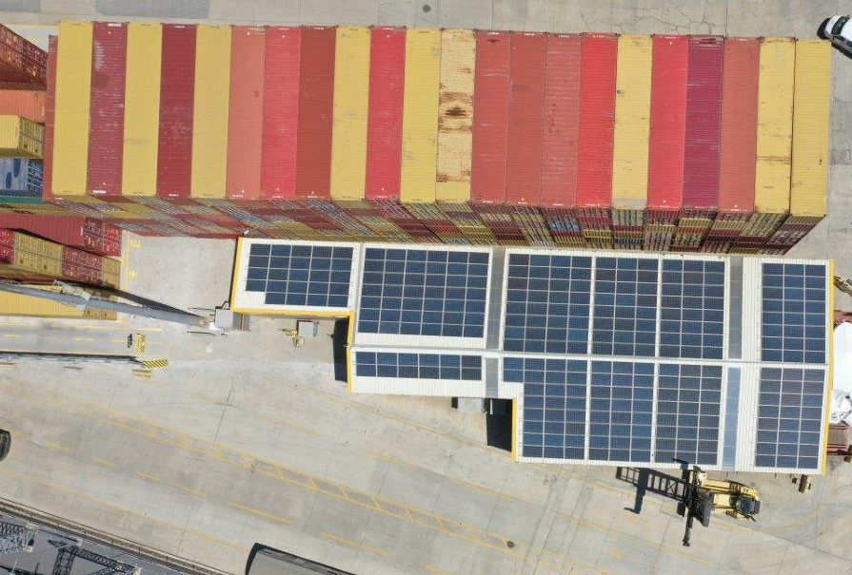
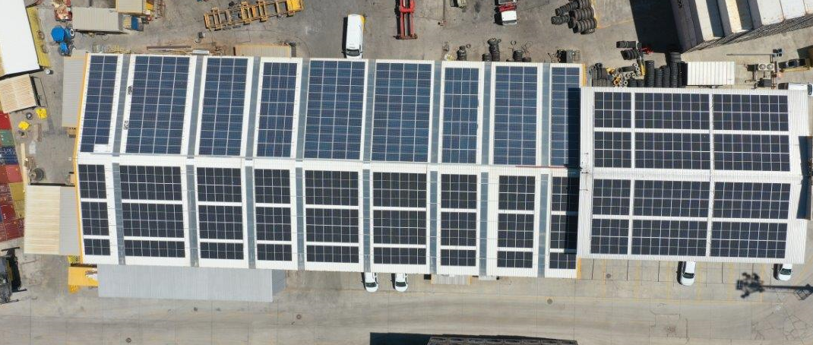
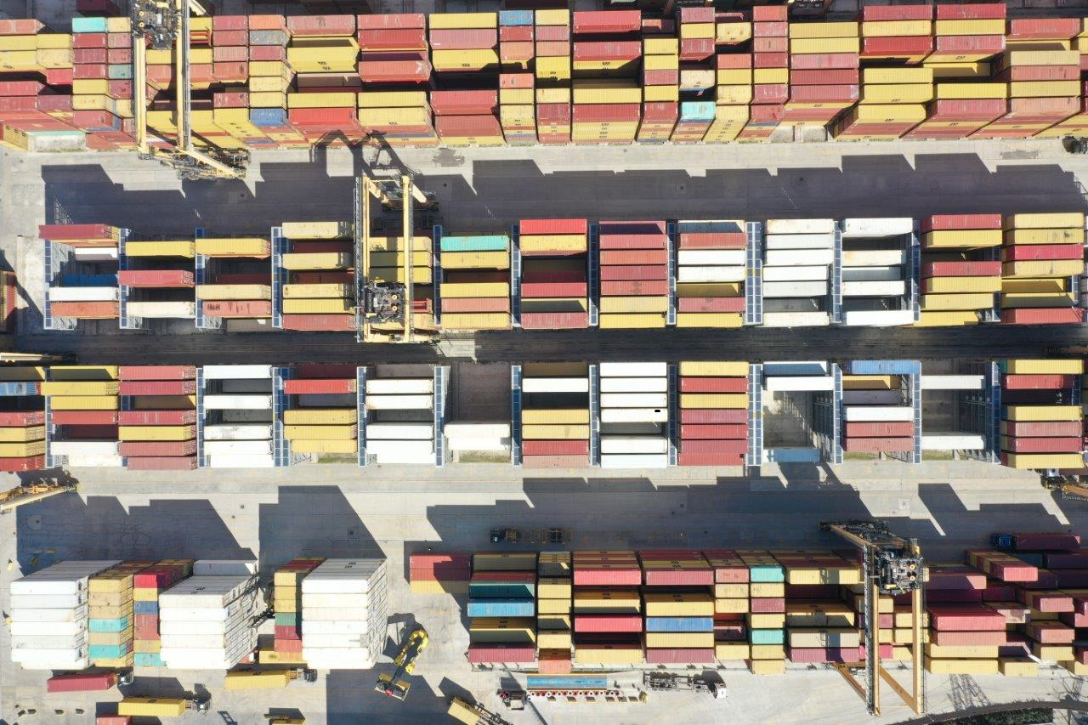
ENVIRONMENTAL REPORT 2022
ENERGY, NATURAL RESOURCES USE AND RESOURCES
Electricity Produce
Asyaport have the Solar Energy System which produce electricity. A part of electricity using is generated by the 1280 panel Solar Energy system. Installed power of the port solar energy system is 323.54 kW. In 2022, 319.344 kWh energy was generated by solar system, and total generation of energy is 1.844.800 kWh from 2014, the year of the system was established.

Slide 15
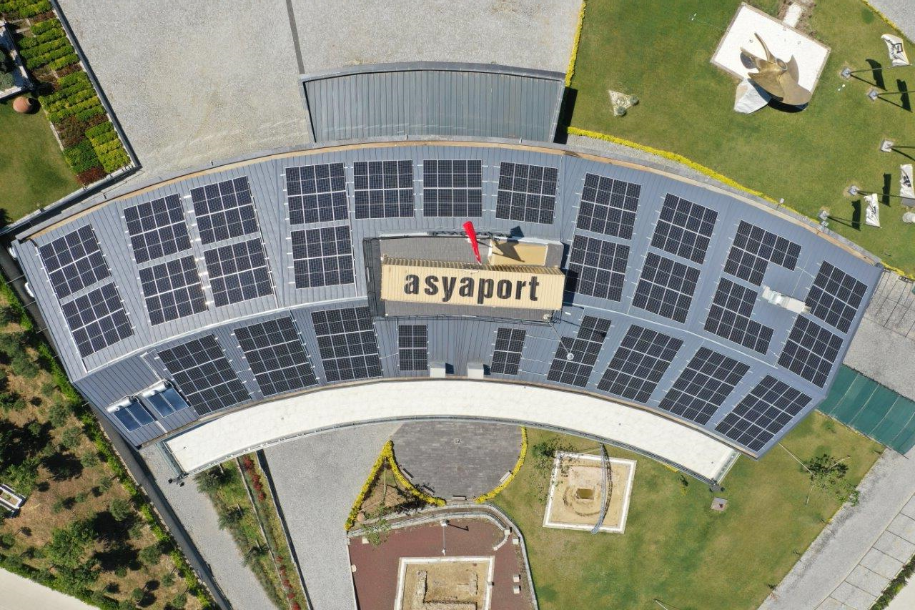
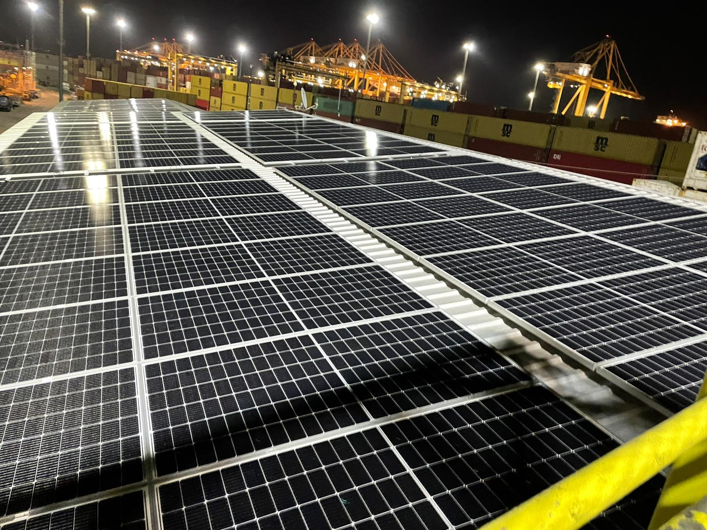
ENVIRONMENTAL REPORT 2022
ENERGY, NATURAL RESOURCES USE AND RESOURCES
Electricity Produce
As an environmentally friendly and green port, Asyaport continues its attractive energy investments while carrying out normal management, and finally, in April 2022, it acquired the second phase solar power plant investment, which consists of 898 PV panels and has an installed power of 409kW. The solar power plant will be used as self-consumption and will be used for the internal needs of the port as the suspension of all the electricity produced. The return time of the investment is 3 if the load is less. and we will contribute to nature as much as 11650 trees.

Slide 16
ENVIRONMENTAL REPORT 2022
ENERGY, NATURAL RESOURCES USE AND RESOURCES

Slide 17
ENVIRONMENTAL REPORT 2022
WASTE MANAGEMENT
ASYAPORT, It provides the management of wastes in accordance with the legal framework within the scope of environmental legislation. The wastes generated in the port are divided into classes and stored separately according to their types, kept in legal periods and sent to licensed recycling or disposal facilities through licensed companies.
Wastes exist in Asyaport temporary storage area are separated according to grade and type of hazard. There is a drainage system for the group of hazardous wastes. These wastes are disposed to contract companies in certain periods.

Slide 18
ENVIRONMENTAL REPORT 2022
WASTE MANAGEMENT
ASYAPORT, It provides the management of wastes in accordance with the legal framework within the scope of environmental legislation. The wastes generated in the port are divided into classes and stored separately according to their types, kept in legal periods and sent to licensed recycling or disposal facilities through licensed companies.

Slide 19
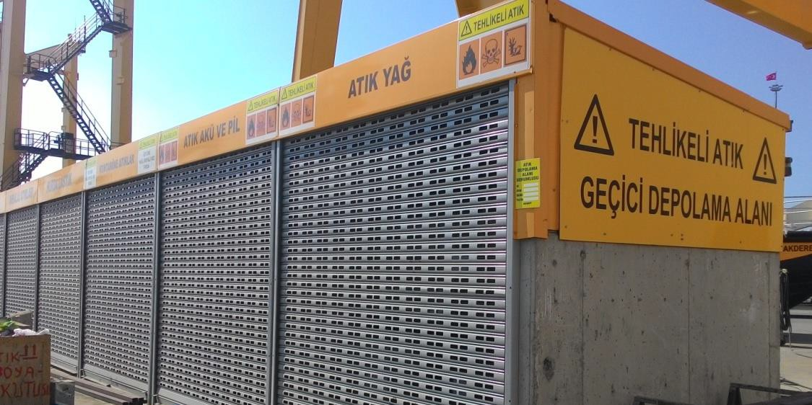
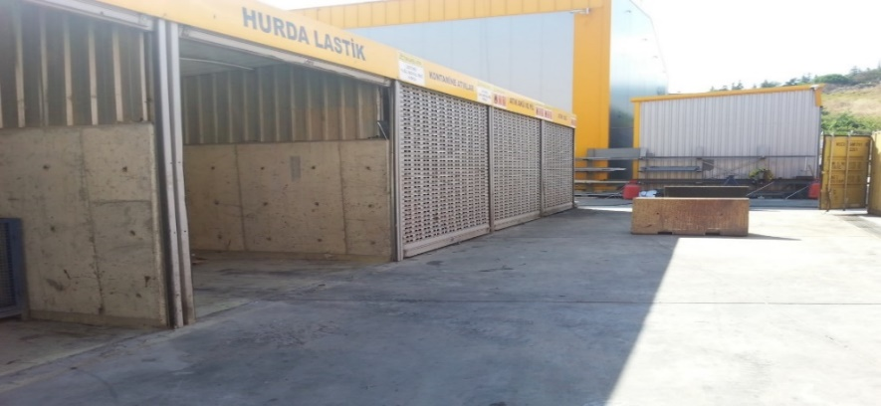
ENVIRONMENTAL REPORT 2022
WASTE MANAGEMENT
Wastes exist in Asyaport temporary storage area are separated according to grade and type of hazard. There is a drainage system for the group of hazardous wastes. These wastes are disposed to contract companies in certain periods.

Slide 20
ENVIRONMENTAL REPORT 2022
WATER AND WASTEWATER TREATMENT
Within the port;
domestic wastewater from ships, domestic wastewater from the port, rain water generated within the facility and the wastewater resulting from the treatment of wastewater generated after dewatering the bilge water taken from the ships and are collected.
In 2022 year 399.200 kg treated waste water was sent to municipal treatment.
A rainwater collection channel has been laid in the port area to collect the rain falling within the body of Asyaport Port. Asyaport has two water drainage systems for rainwater. Rain water coming from the roofs of Asiaport buildings is collected in a single line. The other drainage system is a grease trap system. The water is sent to the sea after the oil and dirt that may be in the rain water are kept by the oil trap.

Slide 21
ENVIRONMENTAL REPORT 2022
WATER AND WASTEWATER TREATMENT
Marine Water Quality
There is a public beach right next to the harbor. The water quality of this beach is examined periodically by samples taken by the Ministry of Health. In addition, ASYAPORT Water quality is monitored twice a year by analyzing sea water taken from various points and depths. Our port follows the results of the analysis and takes extra care to protect the local people's routine life conditions.

Slide 22
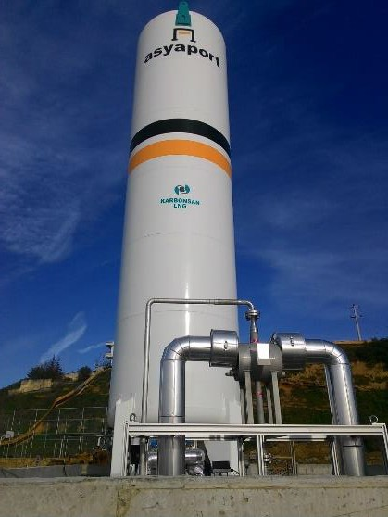
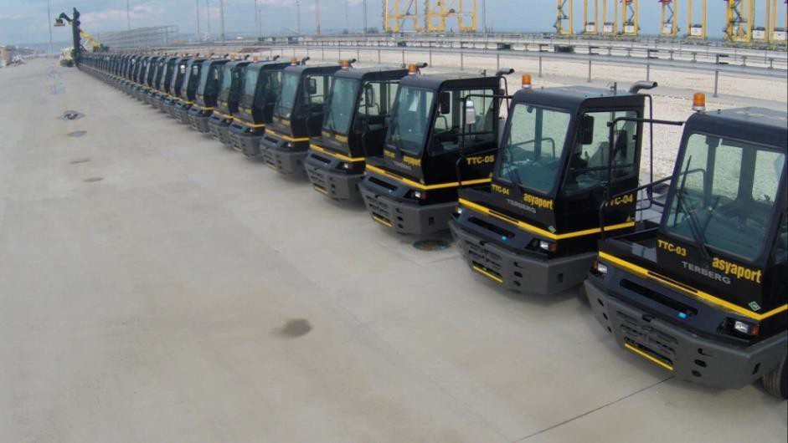
ENVIRONMENTAL REPORT 2022
AIR POLLUTION CONTROL
Emission
Asyaport activates all cranes by the electric energy to reduce the carbon output and on behalf of doing no harm the environment during the operations. Also, the port prefers LNG, used in Türkiye for the first time, instead of the diesel fuel on the inside transporter at the port.
Asyaport minimized the carbon emission of the cranes and the inside transporters. There is no open stored bulk material that can be emission source in Asyaport. Containers are stored only. So Asyaport does not have any emission source. The Emission Exemption Certificate Allowance was given for emission to ASYAPORT from Tekirdağ Ministry of Environment and Urbanization Committee.

Slide 23
ENVIRONMENTAL REPORT 2022
GREENHOUSE GASES MANAGEMENT
Within the scope of greenhouse gas management, greenhouse gas calculations arising from activities carried out within the facility are made and reported.
Scope 1 Emissions, 2022
Scope 2 Emissions, 2022

Slide 24
ENVIRONMENTAL REPORT 2022
GREENHOUSE GASES MANAGEMENT
Targeting to be a sustainable port for a sustainable environment, Asyaport uses LNG in in-port carriers in Europe and Türkiye for the first time so that the carbon release dropped by 1,230 tons a year. Diesel-powered vehicles release 253 kg CO2 emission for 1000 kWh energy while LNG-powered vehicles release 185 kg CO2 emission.

Slide 25
ENVIRONMENTAL REPORT 2022
GREENHOUSE GASES MANAGEMENT
ASYAPORT provides the calculation of greenhouse gas emissions under its operational control in relation to the activities it carries out and carries out Greenhouse Gas Management.
As ASYAPORT is a growing and developing business, energy consumption will increase. The important thing is to minimize greenhouse gas emissions while consuming energy. Solar energy panels, LED lighting, LNG usage in ASYAPORT are concrete investments made for greenhouse gas emission reduction.
QSI has verified the green house gas statement report of the organize in for the above mentioned verification period has been prepared in according to the TS EN ISO 14064-1 requirements , according to the TS EN ISO 14064-3 standard
Verification explanation -1 :Greenhouse gas statement has been prepared in accordance eith the requirements of TS EN ISO 1464-1:2006
Verification statement-2 : Direct and indirect emissions verified as 15088,83 (15089) tonnes CO2eq
Scope 1 emissions 6864,81 CO2eq
Scope 2 emissions 8224,02 CO2eq

Slide 26
ENVIRONMENTAL REPORT 2022
NOISE MANAGEMENT
ASYAPORTis founded 500 m far from the settlement place. Facilities that founded 500 m. far from the settlement place are exempted from noise permit according to the Ministry of Environment and Urbanisation regulations. The measurement of noise in the working environment was made according to the Occupational Health and Safety Law. Noise levels are monitored. In addition, the environmental noise measurement is measured internally for control purposes.
SOIL POLLUTION
There are no sources of pollution will affect the soil on the port. Even if any leakage, Asyaport has impermeable concrete floor.
MANAGEMENT OF CHEMICALS
SDS for all chemicals used in the Asyaport current and up to date. Storage and use of chemicals are carried out in accordance with relevant regulations. All employees have received IMDG awareness training. IMDG Code trainings are going on for duty.

Slide 27
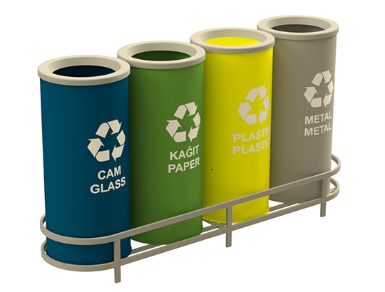
ENVIRONMENTAL REPORT 2022
ZERO WASTE MANAGEMENT
"Zero Waste Project"; Within the scope of the regulation published on 12 July 2019, it is a waste management project that includes the prevention of waste, the more efficient use of resources, the prevention or minimization of waste generation by reviewing the causes of waste generation, and the collection and recovery of waste at the source if it occurs. Asyaport started works with zero waste in October 2019. Till the end of 2019, staff and stakeholders have been trained, waste boxes have been provided and started to be used in the scope of the regulation. Zero waste basic level certificate has been received in June after the application is made in April 2020.
Asyaport saved 83,34mt³ water, 22,61m³ storage area and 29.845,5kWh energy by 8.400 tons of waste collected and recycled in the 2022 so that of 73 trees, 9,307,94 liter petroleum, 1,24 ton glass raw materials and 0.264 ton metal raw materials was saved from consumption.

Slide 28
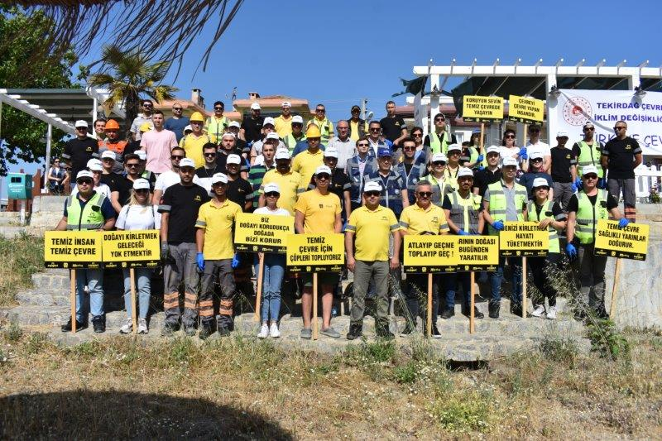
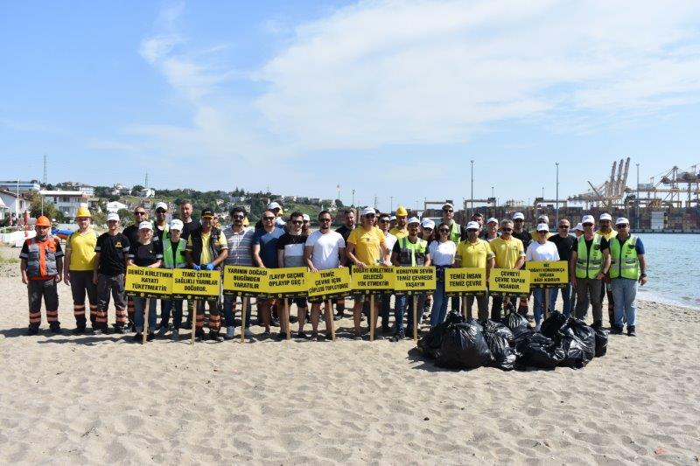
ENVIRONMENTAL REPORT 2022
WORD ENVİROMENT DAY
As part of the "Leave Zero Waste to the Future" project organized by Asyaport on World Environment Day, Gündal Beach was cleaned together by our employees.

Slide 29
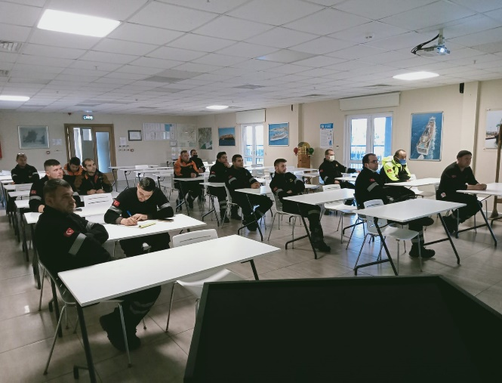
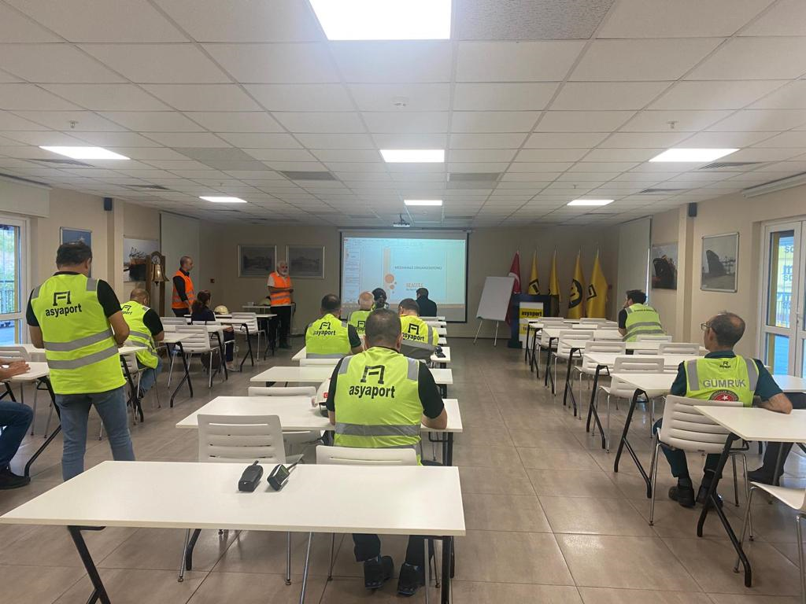
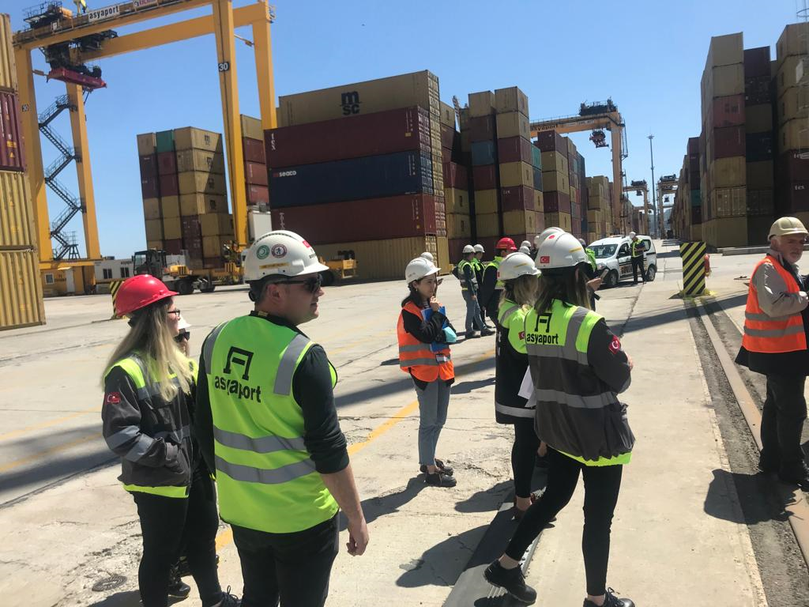
ENVIRONMENTAL REPORT 2022
ENVIROMENTAL TRAİNİNG
Training is provided for ASYAPORT employees both within the scope of environmental legislation and in order to raise general environmental awareness. In the trainings for employees, general information is given about the definition of the environment, what are the administrative sanctions regarding the environment, our citizenship duties according to the environmental legislation, what is the waste, the separation of wastes according to their types, management and what kind of environment and waste management will be in our port. In 2022, a total of 650 people were trained.
Marine pollution trainings are given by the Seagull company twice a year.

Slide 30
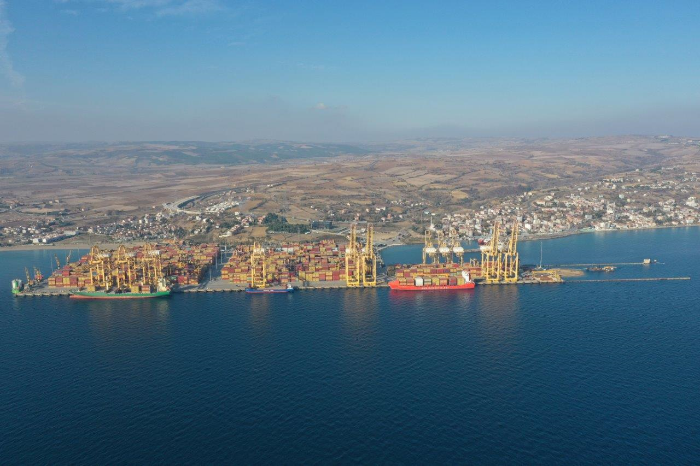
ASYAPORT 2022 ENVIRONMENTAL REPORT

